Slide 1
DATA MINING LECTURE 6
Clustering

Slide 2
CLUSTERING

Slide 3
What is a Clustering?
In general a grouping of objects such that the objects in a group (cluster) are similar (or related) to one another and different from (or unrelated to) the objects in other groups
Inter-cluster distances are maximized
Intra-cluster distances are minimized

Slide 4
Applications of Cluster Analysis
Understanding
Group related documents for browsing, group genes and proteins that have similar functionality, or group stocks with similar price fluctuations
Summarization
Reduce the size of large data sets

Slide 5
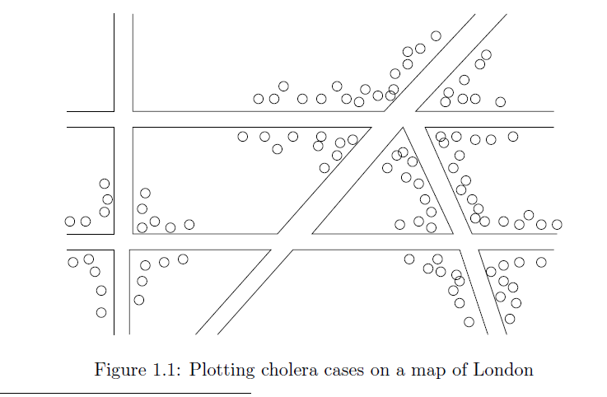
Early applications of cluster analysis
John Snow, London 1854

Slide 6
Notion of a Cluster can be Ambiguous
How many clusters?
Six Clusters
Two Clusters
Four Clusters

Slide 7
Types of Clusterings
A clustering is a set of clusters
Important distinction between hierarchical and partitional sets of clusters
Partitional Clustering
A division data objects into subsets (clusters) such that each data object is in exactly one subset
Hierarchical clustering
A set of nested clusters organized as a hierarchical tree

Slide 8
Partitional Clustering
Original Points
A Partitional Clustering

Slide 9
Hierarchical Clustering
Hierarchical Clustering
Dendrogram

Slide 10
Other types of clustering
Exclusive (or non-overlapping) versus non-exclusive (or overlapping)
In non-exclusive clusterings, points may belong to multiple clusters.
Points that belong to multiple classes, or ‘border’ points
Fuzzy (or soft) versus non-fuzzy (or hard)
In fuzzy clustering, a point belongs to every cluster with some weight between 0 and 1
Weights usually must sum to 1 (often interpreted as probabilities)
Partial versus complete
In some cases, we only want to cluster some of the data

Slide 11
Types of Clusters: Well-Separated
Well-Separated Clusters:
A cluster is a set of points such that any point in a cluster is closer (or more similar) to every other point in the cluster than to any point not in the cluster.
3 well-separated clusters

Slide 12
Types of Clusters: Center-Based
Center-based
A cluster is a set of objects such that an object in a cluster is closer (more similar) to the “center” of a cluster, than to the center of any other cluster
The center of a cluster is often a centroid, the minimizer of distances from all the points in the cluster, or a medoid, the most “representative” point of a cluster
4 center-based clusters

Slide 13
Types of Clusters: Density-Based
Density-based
A cluster is a dense region of points, which is separated by low-density regions, from other regions of high density.
Used when the clusters are irregular or intertwined, and when noise and outliers are present.
6 density-based clusters

Slide 14
Clustering Algorithms
K-means
Hierarchical clustering
DBSCAN

Slide 15
K-means

Slide 16
K-means Clustering
Partitional clustering approach
Each cluster is associated with a centroid (center point)
Each point is assigned to the cluster with the closest centroid
Number of clusters, K, must be specified
The objective is to minimize the sum of distances of the points to their respective centroid

Slide 17
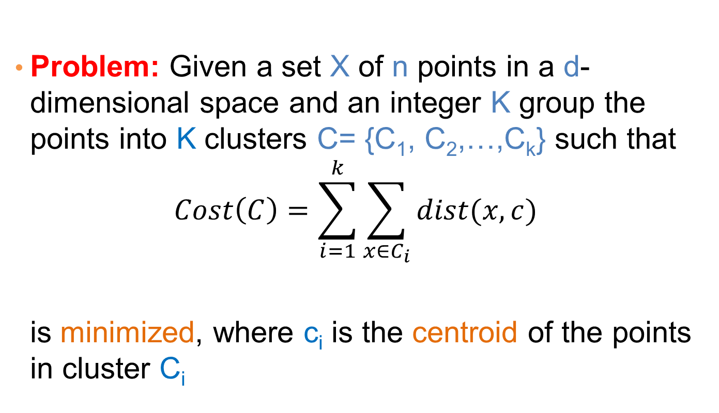
K-means Clustering
Problem: Given a set X of n points in a d-dimensional space and an integer K group the points into K clusters C= {C₁, C₂,…,C_{k}} such that
$$Cost\left(C\right)=\sum_{i=1}^{k}{\sum_{x∈C_{i}}{dist(x,c)}}$$
is minimized, where c_{i} is the centroid of the points in cluster C_{i}

Slide 18
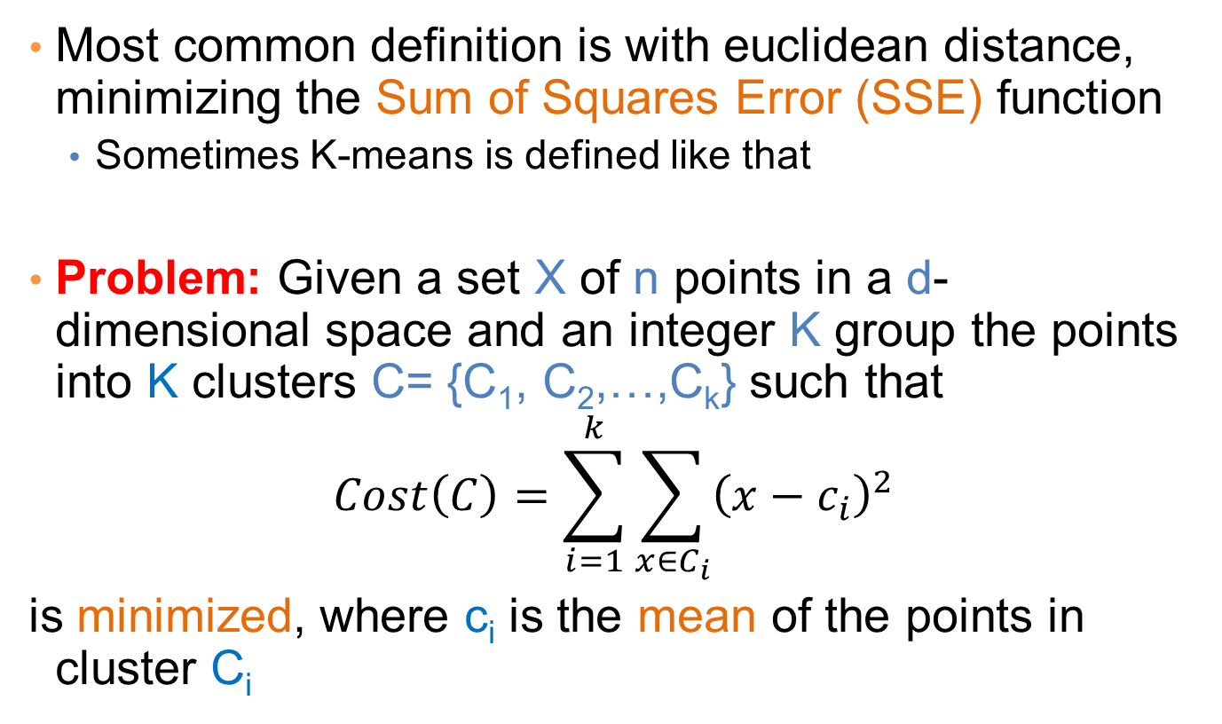
K-means Clustering
Most common definition is with euclidean distance, minimizing the Sum of Squares Error (SSE) function
Sometimes K-means is defined like that
Problem: Given a set X of n points in a d-dimensional space and an integer K group the points into K clusters C= {C₁, C₂,…,C_{k}} such that
$$Cost\left(C\right)=\sum_{i=1}^{k}{\sum_{x∈C_{i}}{{\left(x−c_{i}\right)}^{2}}}$$
is minimized, where c_{i} is the mean of the points in cluster C_{i}
Sum of Squares Error (SSE)

Slide 19
Complexity of the k-means problem
NP-hard if the dimensionality of the data is at least 2 (d>=2)
Finding the best solution in polynomial time is infeasible
A simple iterative algorithm works quite well in practice

Slide 20
K-means Algorithm – Initialization
Initial centroids are often chosen randomly.
Clusters produced vary from one run to another.

Slide 21
Two different K-means Clusterings
Original Points
Optimal Clustering
Sub-optimal Clustering

Slide 22
Importance of Choosing Initial Centroids

Slide 23
Importance of Choosing Initial Centroids

Slide 24
Importance of Choosing Initial Centroids

Slide 25
Importance of Choosing Initial Centroids …

Slide 26
Dealing with Initialization
Do multiple runs and select the clustering with the smallest error
Select original set of points by methods other than random . E.g., pick the most distant (from each other) points as cluster centers (K-means++ algorithm)

Slide 27
K-means Algorithm – Centroids
The centroid depends on the distance function
The minimizer for the distance function
‘Closeness’ is measured by Euclidean distance (SSE), cosine similarity, etc.
Centroid:
The mean of the points in the cluster for SSE, and cosine similarity
The median for Manhattan distance.
Finding the centroid is not always easy
It can be an NP-hard problem for some distance functions
E.g., median form multiple dimensions

Slide 28
K-means Algorithm – Convergence
K-means will converge for common similarity measures mentioned above.
Most of the convergence happens in the first few iterations.
Often the stopping condition is changed to ‘Until relatively few points change clusters’
Complexity is O( n * K * I * d )
n = number of points, K = number of clusters, I = number of iterations, d = dimensionality
In general a fast and efficient algorithm

Slide 29
Limitations of K-means
K-means has problems when clusters are of different
Sizes
Densities
Non-globular shapes
K-means has problems when the data contains outliers.

Slide 30
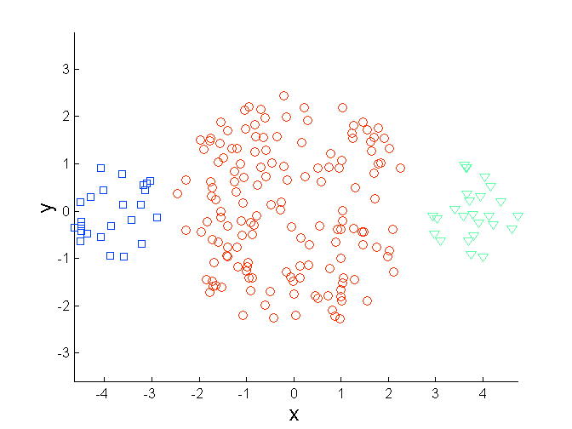
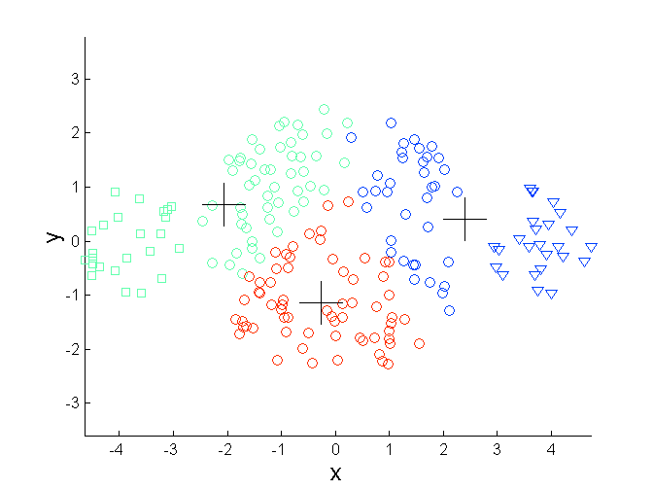
Limitations of K-means: Differing Sizes
Original Points
K-means (3 Clusters)

Slide 31
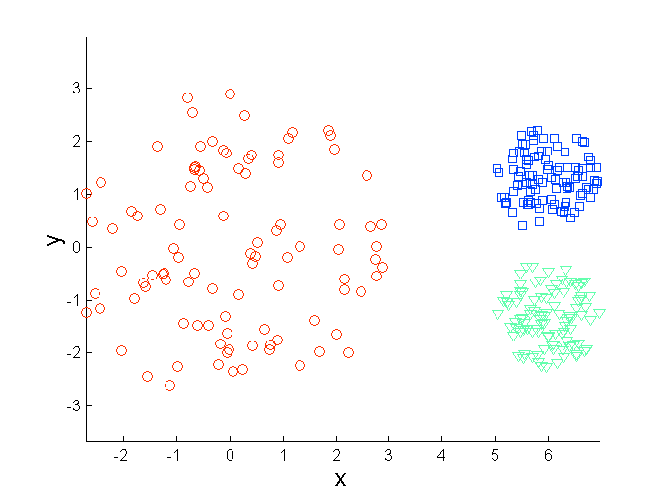
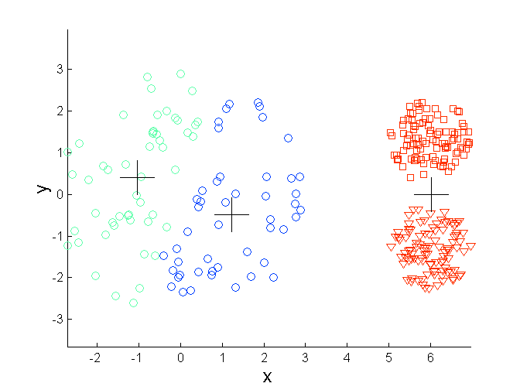
Limitations of K-means: Differing Density
Original Points
K-means (3 Clusters)

Slide 32
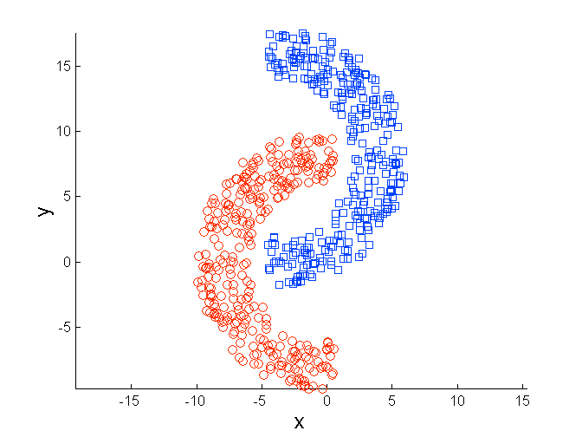
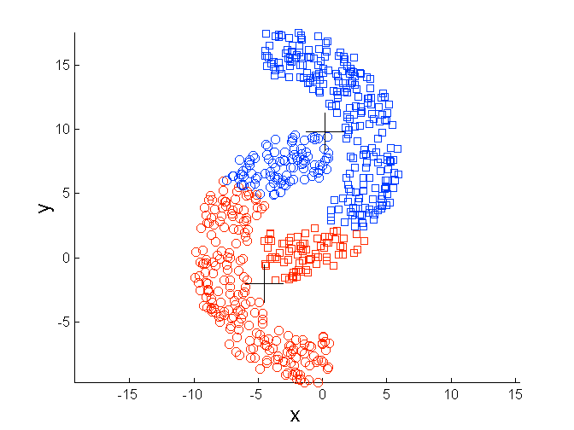
Limitations of K-means: Non-globular Shapes
Original Points
K-means (2 Clusters)

Slide 33
Variations
K-medoids: Similar problem definition as in K-means, but the centroid of the cluster is defined to be one of the points in the cluster (the medoid).
K-centers: Similar problem definition as in K-means, but the goal now is to minimize the maximum diameter of the clusters (diameter of a cluster is maximum distance between any two points in the cluster).

Slide 34
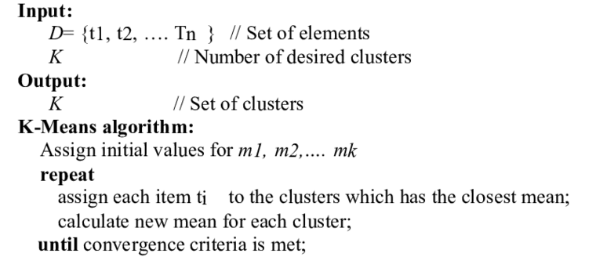
Pseudo Code For Kmeans

Slide 35
Termination conditions
Several possibilities, e.g.,
A fixed number of iterations.
Doc partition unchanged.
Centroid positions don’t change.

